Slide 1

TARGET FOLDER
SRNTGT003
MURMANSK INTERNATIONAL
OPAC CLASSIFIED
REL TO CJTF-23
OPAC CLASSIFIED
REL TO CJTF-23

Slide 2
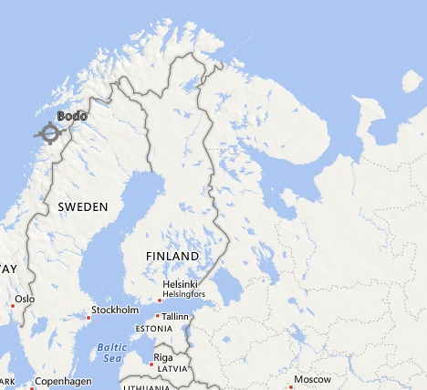
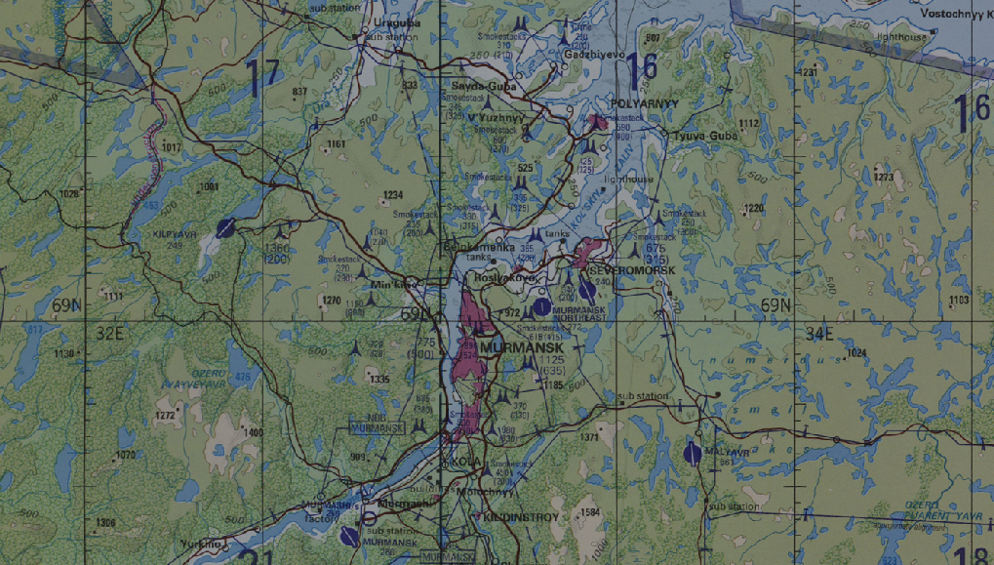
 | MURMANSK INTERNATIONAL, SRN JOINT OPERATIONS GRAPHIC 1/1 | MAP OVERVIEW | OPAC CLASSIFIED REL TO CJTF-23
 | BE:SRNTGT003 CATCODE: 3 MIDB GEO: N 68 46.936 E 032 44.996 ICOD: 2011-07-01 DOI: 2011-05-12 |  | DECL ON: 2061-01-01(+50 YEARS)
OPAC CLASSIFIED
N
MURMANSK INTERNATIONAL
SRNTGT003
.
OPAC CLASSIFIED
REL TO CJTF-23

Slide 3
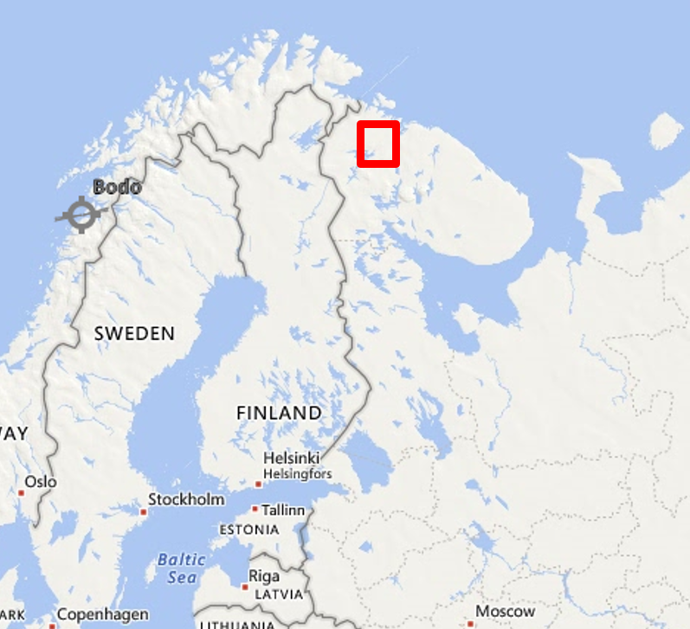
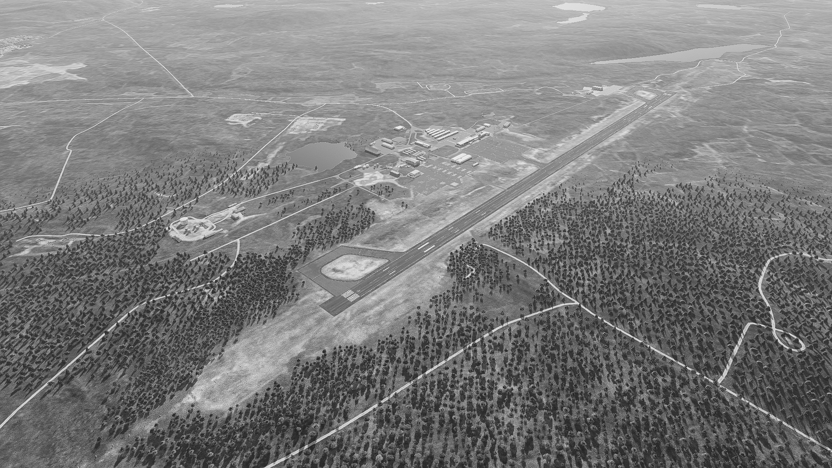
 | MURMANSK INTERNATIONAL, SRN FACILITY OUTLINE GRAPHIC 1/1 | MAP OVERVIEW | OPAC CLASSIFIED REL TO CJTF-23
 | BE:SRNTGT003 CATCODE: 3 MIDB GEO: N 68 46.936 E 032 44.996 ICOD: 2011-07-01 DOI: 2011-05-12 |  | DECL ON: 2061-01-01(+50 YEARS)
OPAC CLASSIFIED
N
OPAC CLASSIFIED
REL TO CJTF-23

Slide 4
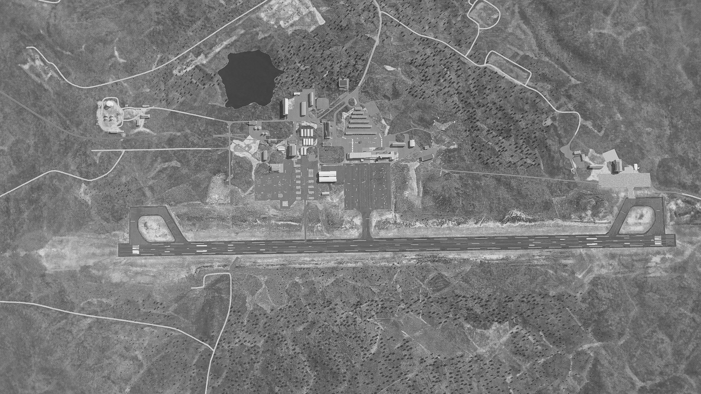
 | MURMANSK INTERNATIONAL SRN JOINT DESIRED POINT OF IMPACT GRAPHIC 1/1 | MAP OVERVIEW | OPAC CLASSIFIED REL TO CJTF-23
 | BE:SRNTGT003 CATCODE: 3 MIDB GEO: N 68 46.936 E 032 44.996 ICOD: 2011-07-01 DOI: 2011-05-12 |  | DECL ON: 2061-01-01(+50 YEARS)
OPAC CLASSIFIED
DPI G
DPI A
N
DPI B
DPI F
DPI C
DPI K
DPI L
DPI E
DPI D
DPI H
JDPI: SRNTGT002A
AMMO STORAGE ON GND
N 68 47.338 E 032 45.464
JDPI MSL: 77 FT
JDPI: SRNTGT002B
FUEL STORAGE ON GND
N 68 47.345 E 032 45.222 JDPI MSL: 77 FT
JDPI: SRNTGT002C
AMMO STORAGE ON GND
N 68 47.629 E 032 44.868
JDPI MSL: 77 FT
DPI J
DPI I
JDPI: SRNTGT002D
AMMO STORAGE ON GND
N 68 47.635 E 032 44.805
JDPI MSL: 77 FT
JDPI: SRNTGT002L
AMMO STORAGE ON GND
N 68 46.997 E 032 45.686
JDPI MSL: 77 FT
JDPI: SRNTGT002E
FUEL STORAGE ON GND
N 68 47.699 E 032 44.736
JDPI MSL: 77 FT
JDPI: SRNTGT002F
FUEL STORAGE ON GND
N 68 47.712 E 032 44.714
JDPI MSL: 77 FT
JDPI: SRNTGT002G
FUEL STORAGE ON GND
N 68 47.723 E 032 44.807
JDPI MSL: 77 FT
JDPI: SRNTGT002H
RUNWAY EAST
N 68 46.677 E 032 45.492
JDPI MSL: 77 FT
JDPI: SRNTGT002I
RUNWAY CENTRE
N 68 46.985 E 032 44.927
JDPI MSL: 77 FT
JDPI: SRNTGT002J
RUNWAY EAST
N 68 47.193 E 032 44.537
JDPI MSL: 77 FT
JDPI: SRNTGT002K
AMMO STORAGE ON GND
N 68 47.037 E 032 45.615
JDPI MSL: 77 FT
OPAC CLASSIFIED
REL TO CJTF-23

Slide 5
 | MURMANSK INTERNATIONAL, SRN WEAPONEERING OPTIONS 1/1 | MAP OVERVIEW | OPAC CLASSIFIED REL TO CJTF-23
 | BE:SRNTGT003 CATCODE: 3 MIDB GEO: N 68 46.936 E 032 44.996 ICOD: 2011-07-01 DOI: 2011-05-12 |  | DECL ON: 2061-01-01(+50 YEARS)
OPAC CLASSIFIED
JDPI | DESCRIPTION | TLE | WARHEAD | GUIDANCE | DESIRED EFFECT | IMPACT ANGLE | FUZING
A | AMMO STORAGE | CAT I | 2000lb GP | METRIC | BLAST | 60-90° | 10ms
B | FUEL STORAGE | CAT I | 2000lb GP | METRIC | BLAST | 90° | 10ms
C | AMMO STORAGE | CAT I | 2000lb GP | METRIC | BLAST | 60-90° | 10ms
D | AMMO STORAGE | CAT I | 2000lb GP | METRIC | BLAST | 60-90° | 10ms
E | FUEL STORAGE | CAT I | 2000lb GP | METRIC | BLAST | 90° | 10ms
F | FUEL STORAGE | CAT I | 2000lb GP | METRIC | BLAST | 90° | 10ms
G | FUEL STORAGE | CAT I | 2000lb GP | METRIC | BLAST | 90° | 10ms
H | RUNWAY EAST | CAT I | AS REQUIRED | METRIC | CRATERING | 90° | 10ms
I | RUNWAY CENTRE | CAT I | AS REQUIRED | METRIC | CRATERING | 90° | 10ms
J | RUNWAY WEST | CAT I | AS REQUIRED | METRIC | CRATERING | 90° | 10ms
K | AMMO STORAGE | CAT I | 2000lb GP | METRIC | BLAST | 60-90° | 10ms
L | AMMO STORAGE | CAT I | 2000lb GP | METRIC | BLAST | 60-90° | 10ms
OPAC CLASSIFIED
REL TO CJTF-23

Slide 6
 | MURMANSK INTERNATIONAL, SRN COLLATERAL DAMAGES ESTIMATION 1/1 | MAP OVERVIEW | OPAC CLASSIFIED REL TO CJTF-23
 | BE:SRNTGT003 CATCODE: 3 MIDB GEO: N 68 46.936 E 032 44.996 ICOD: 2011-07-01 DOI: 2011-05-12 |  | DECL ON: 2061-01-01(+50 YEARS)
OPAC CLASSIFIED
COLLATERAL DAMAGES WITHIN A 500M RADIUS
DESCRIPTION |  | CATCODE | MIDB GEOS | LOCATION | REMARKS
NO STRIKE ENTITIES WITHIN A 500M RADIUS
NSE ID | DESCRIPTION | CATCODE | MIDB GEOS | LOCATION | REMARKS
CLOSEST CDE RISK 900 METERS AWAY FROM TARGET; NO FACTOR
OPAC CLASSIFIED
REL TO CJTF-23

Slide 7
ACRONYMS
ACRONYM | MEANING | DEFINITION
BE | Basic Encyclopedia Number | Alpha/numeric code unique to an installation for incorporation within various national and tactical systems.
CATCODE | Category Code | The data Element that classifies the function and purpose of an installation or a facility.
MIDB | Modernized Integrated Database | A database comprised of information on facilities of military significance, military forces, and related equipment.
ICOD | Intelligence Cut Off Date | The date of the latest intelligence data inputted to a feature.
DOI | Date of Image | Date on which a geospatial or intelligence-related image was captured.
CE | Critical Element | An element of an entity or object that enables it to perform its primary function.
PV CHAR | Physical Vulnerability Characteristic | Standardized alphanumeric code describing the physical and structural properties of a target.
JDPI | Joint Desired Point of Impact | A unique, alphanumeric coded aimpoint identified by a three dimensional mensurated point. It represents a weapon or capability desired point of impact or penetration.
CE90 | Circular Error at 90% | 90 percent confidence level in the horizontal plane.
LE90 | Linear Error at 90% | 90 percent confidence level in the vertical dimension
MSL | Mean Sea Level | Elevation above Earth reference geoid.
AGL | Above Ground Level | Elevation above ground surface.
NCC | Nearest Collateral Concern | Closest non-targeted structure, area, or entity near a planned point of impact that may be at risk of unintended damage during a military strike.
CER | Collateral effects radius | Radius within which collateral damage might happen based on the weapon's characteristics, the target environment, and other operational factors.
CDE | Collateral damage estimate | Systematic process used in military targeting to evaluate the potential for unintended damage or harm to non-combatant entities, structures, or personnel as a result of a planned strike.
NSE | No Strike Element | Specific entities, locations, or objects that are protected from intentional targeting under the Law of Armed Conflict (LOAC) or by operational policy.

